Slide 1
Group 7 - Eom
Members: Yehan Yang, Jiabo Tong

Slide 2
Yehan Yang’s contribution
Nearly 60% work is done by him.
Front-end: including front-end login, registration, sidebar, personal information display, personal information editing, uploading avatar, car map display and other front-end page writing and its ajax communication request, js, jquery dynamic update page elements, md5 encrypted transmission, etc.Conduct the training strategy and design the program structure.
Backend: Java part controller layer, service layer. Including file upload return URL interface, personal information editing interface, email verification code interface. The Python part is based on Bluetooth to receive the moving trajectory of the car.

Slide 3
Jiabo Tong’s contribution
Nearly 30% work is done by him.
Front-end: robot information display and communication with back-end, as well as subsequent improvement and perfection of front-end work.
Backend: Part of the business logic interface includes the login interface, registration interface, personal information display interface, and robot information display and modification interface of the controller layer. The construction of the database and its connection with the backend, using mybitis plug-in to execute sql database operations related business logic (Mapper layer).

Slide 4
The Front-end

Slide 5
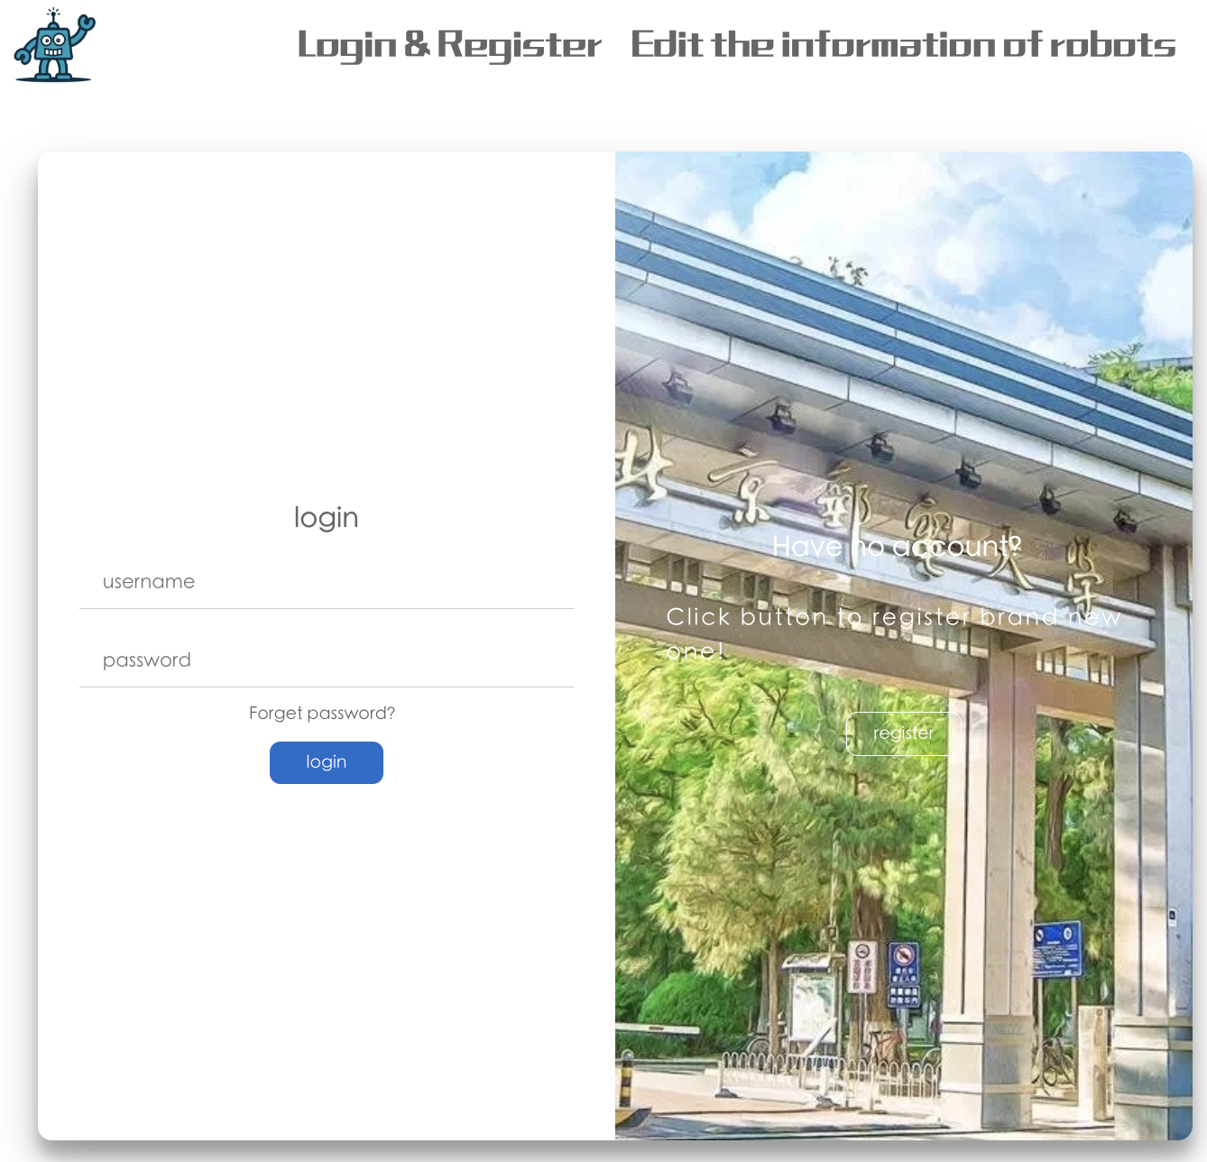
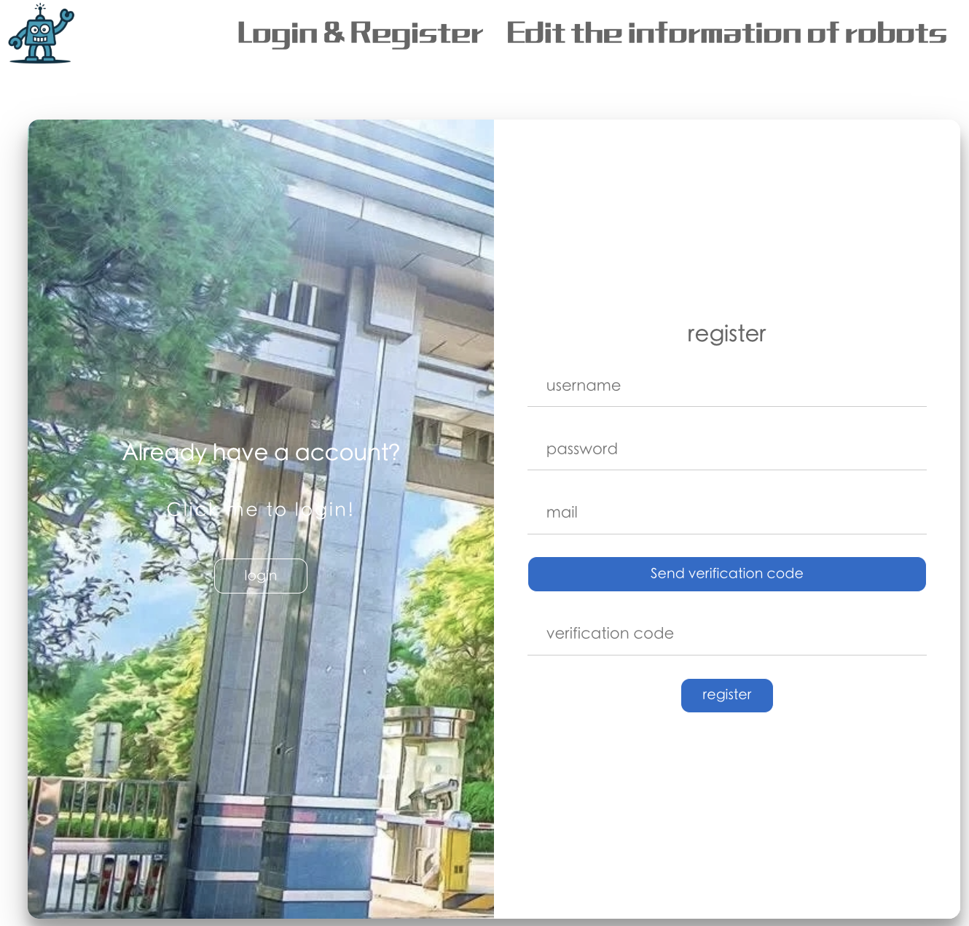
This is our login registration page, you can see it is very distinctive, if you click the registration button on the other side of the window will be smoothly changed to let you fill in the registration information.We even added email verification in the registration screen.
We can randomly choose a teacher's email address to register！

Slide 6
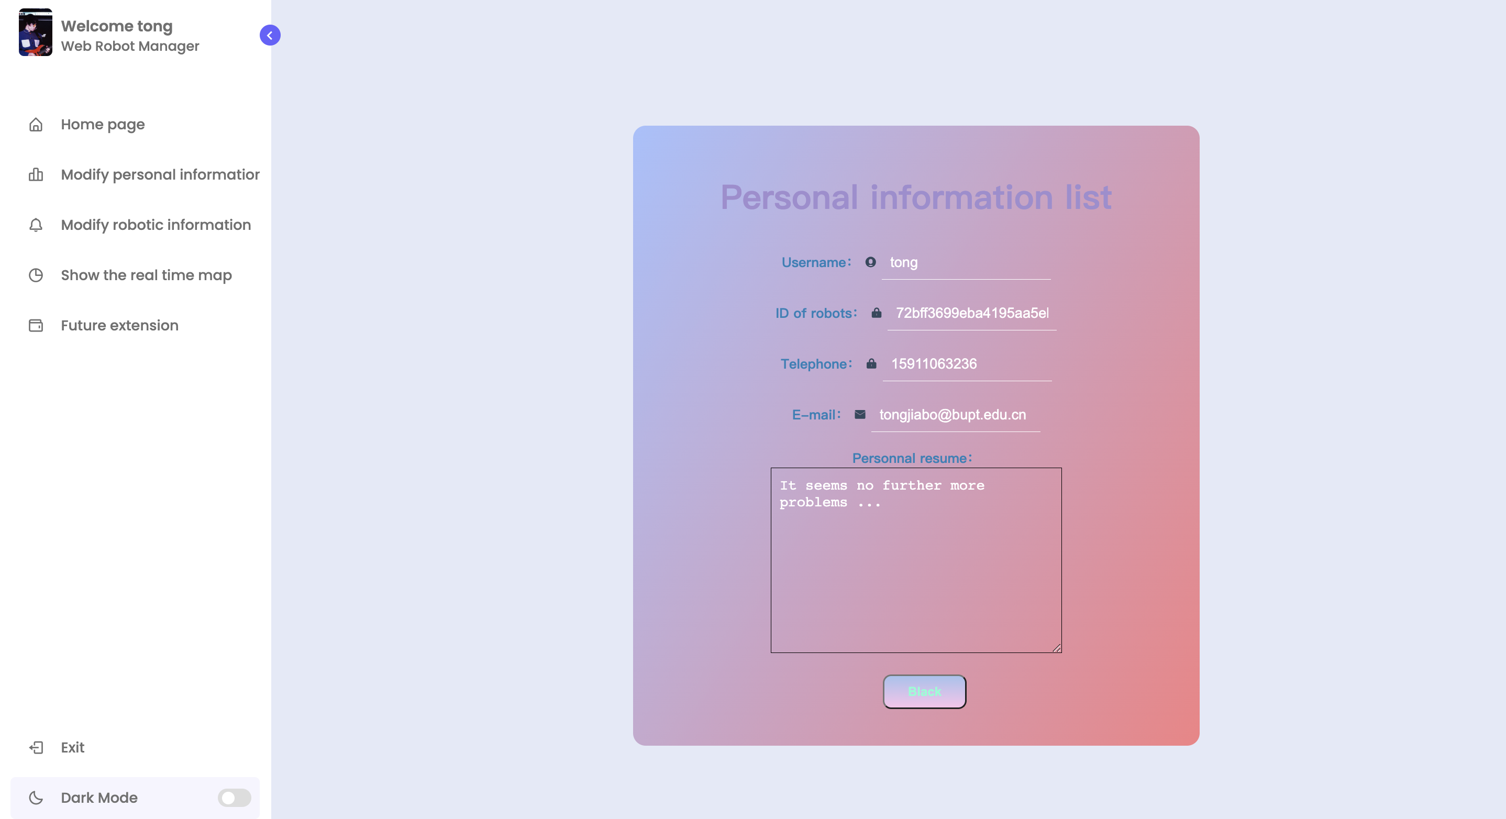

Slide 7
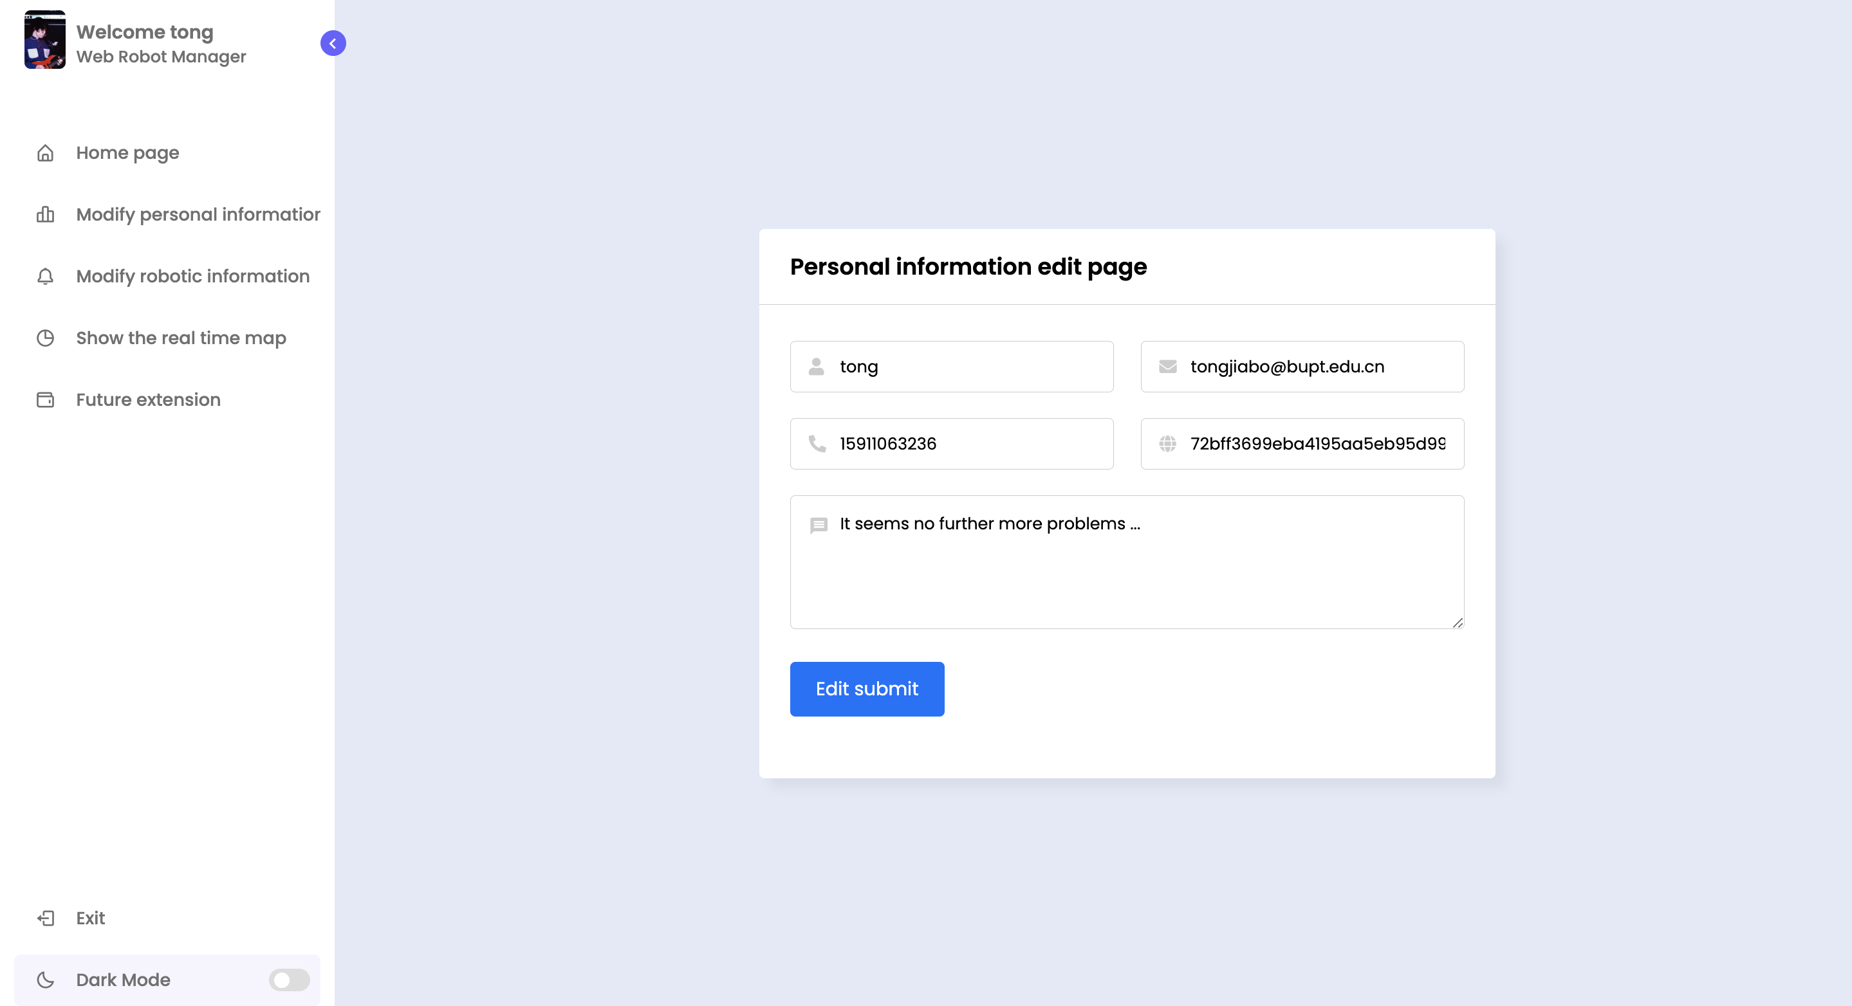

Slide 8
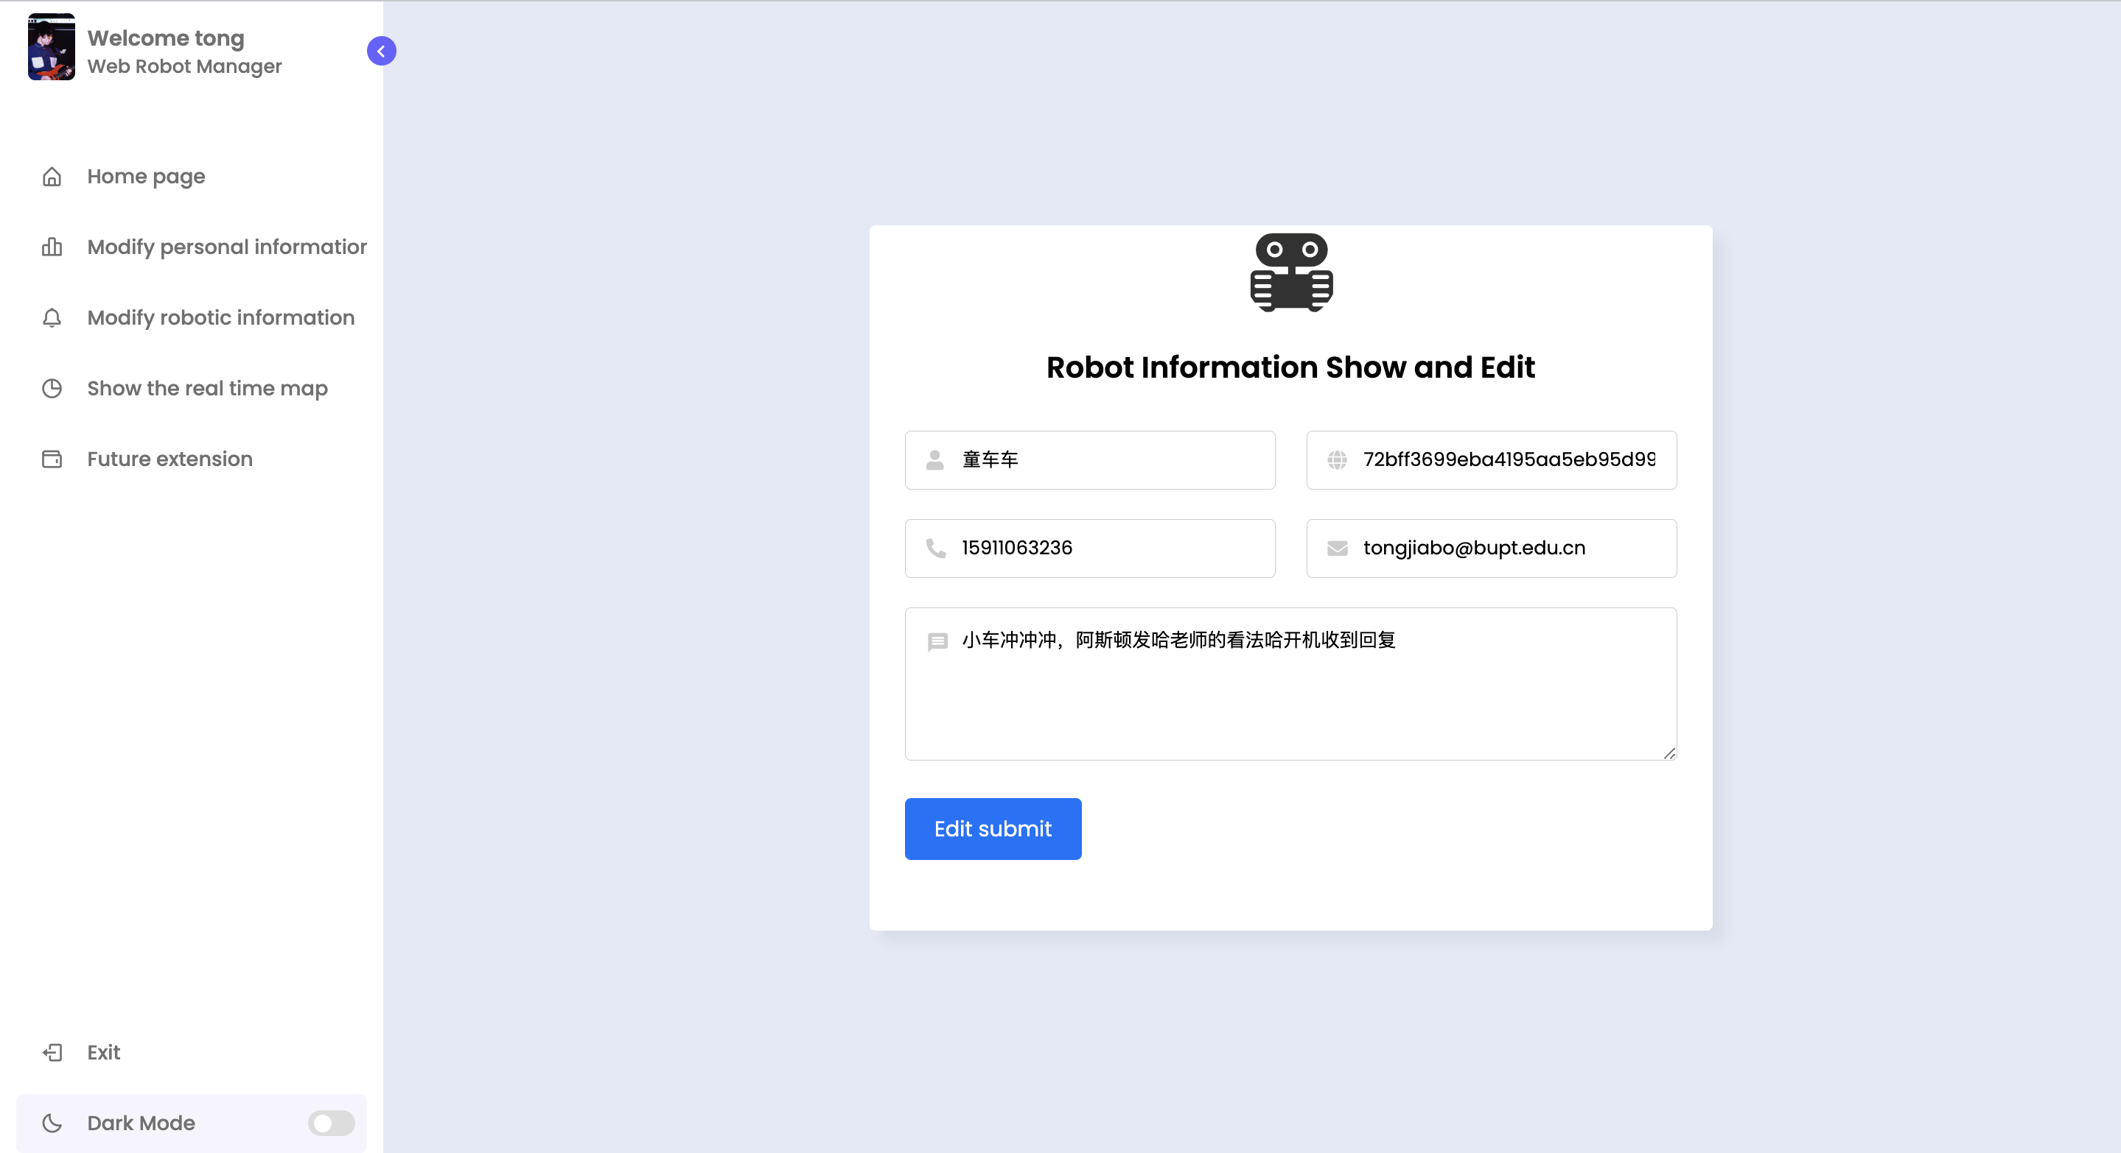

Slide 9
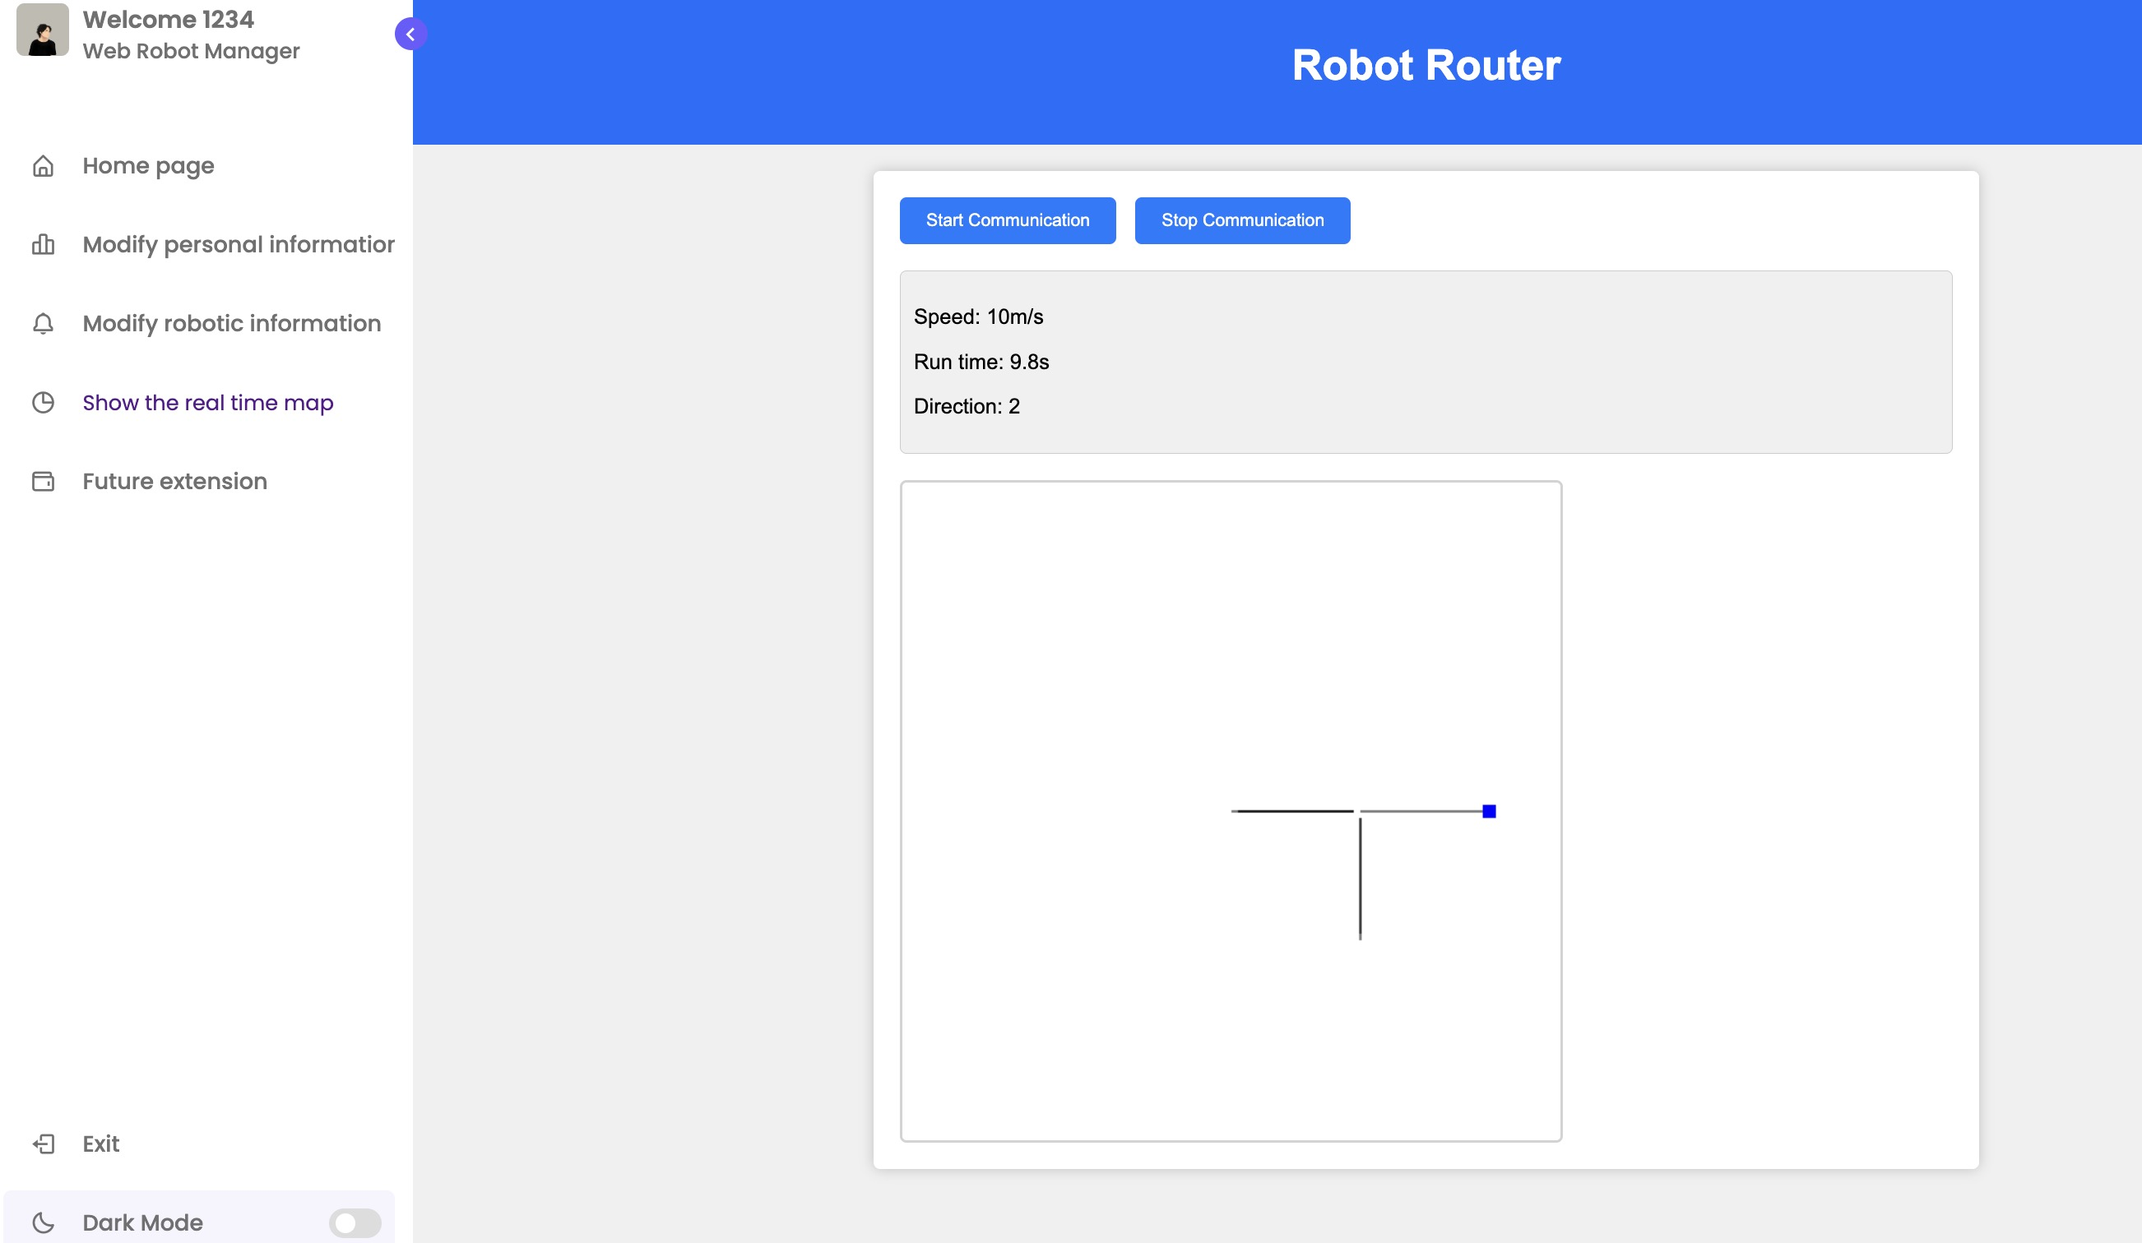

Slide 10
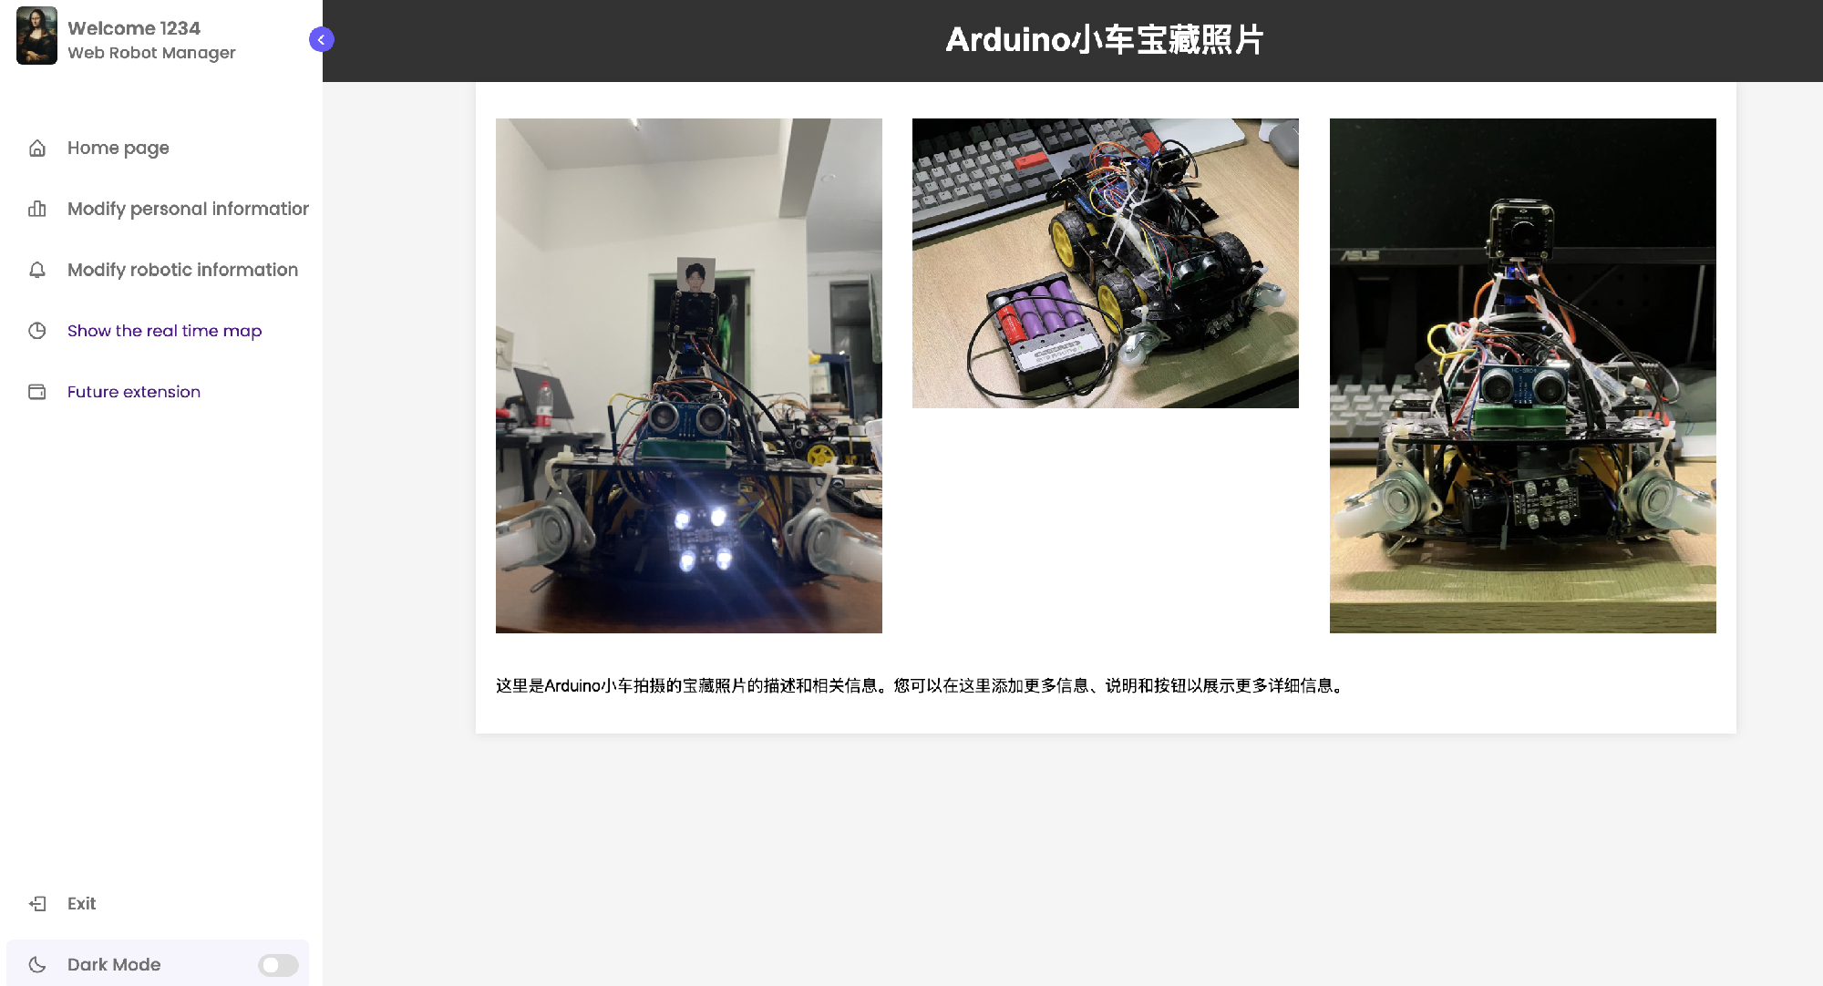

Slide 11
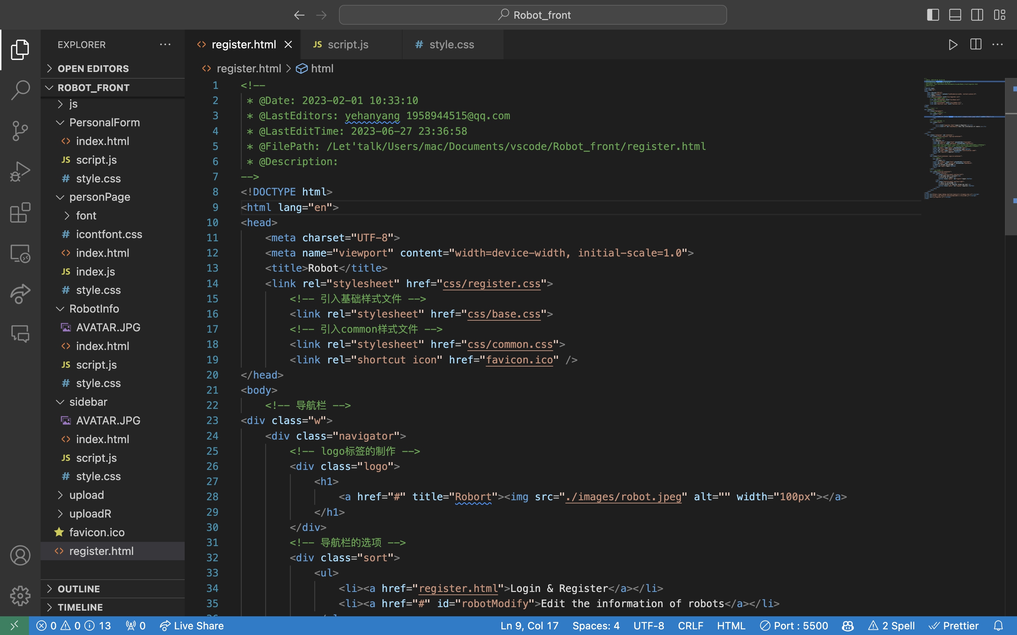
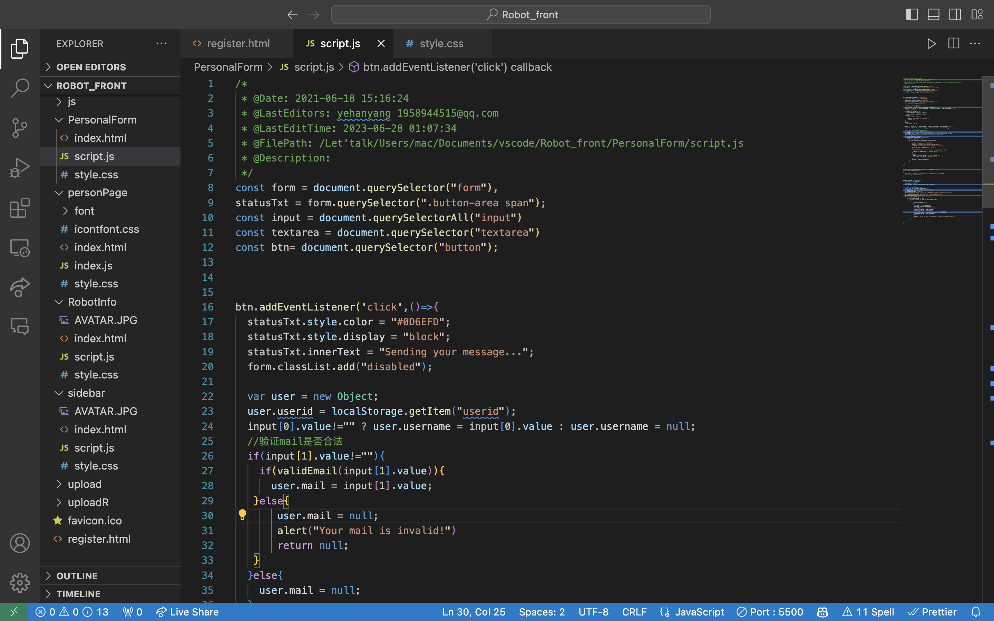
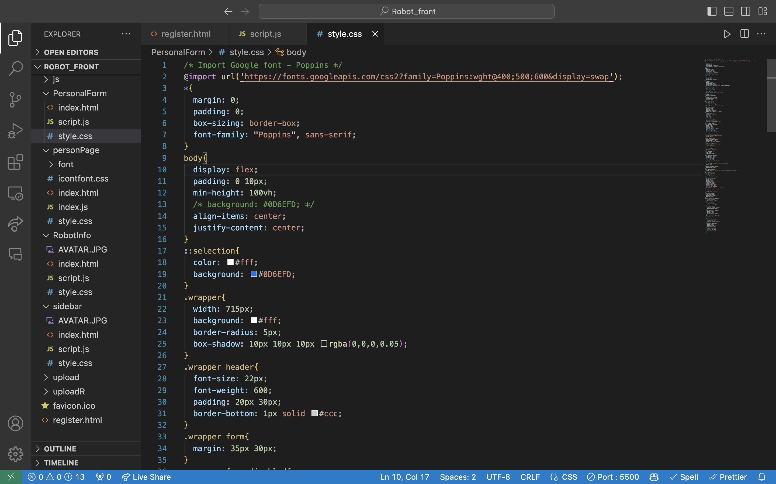

Slide 12
The Backend

Slide 13
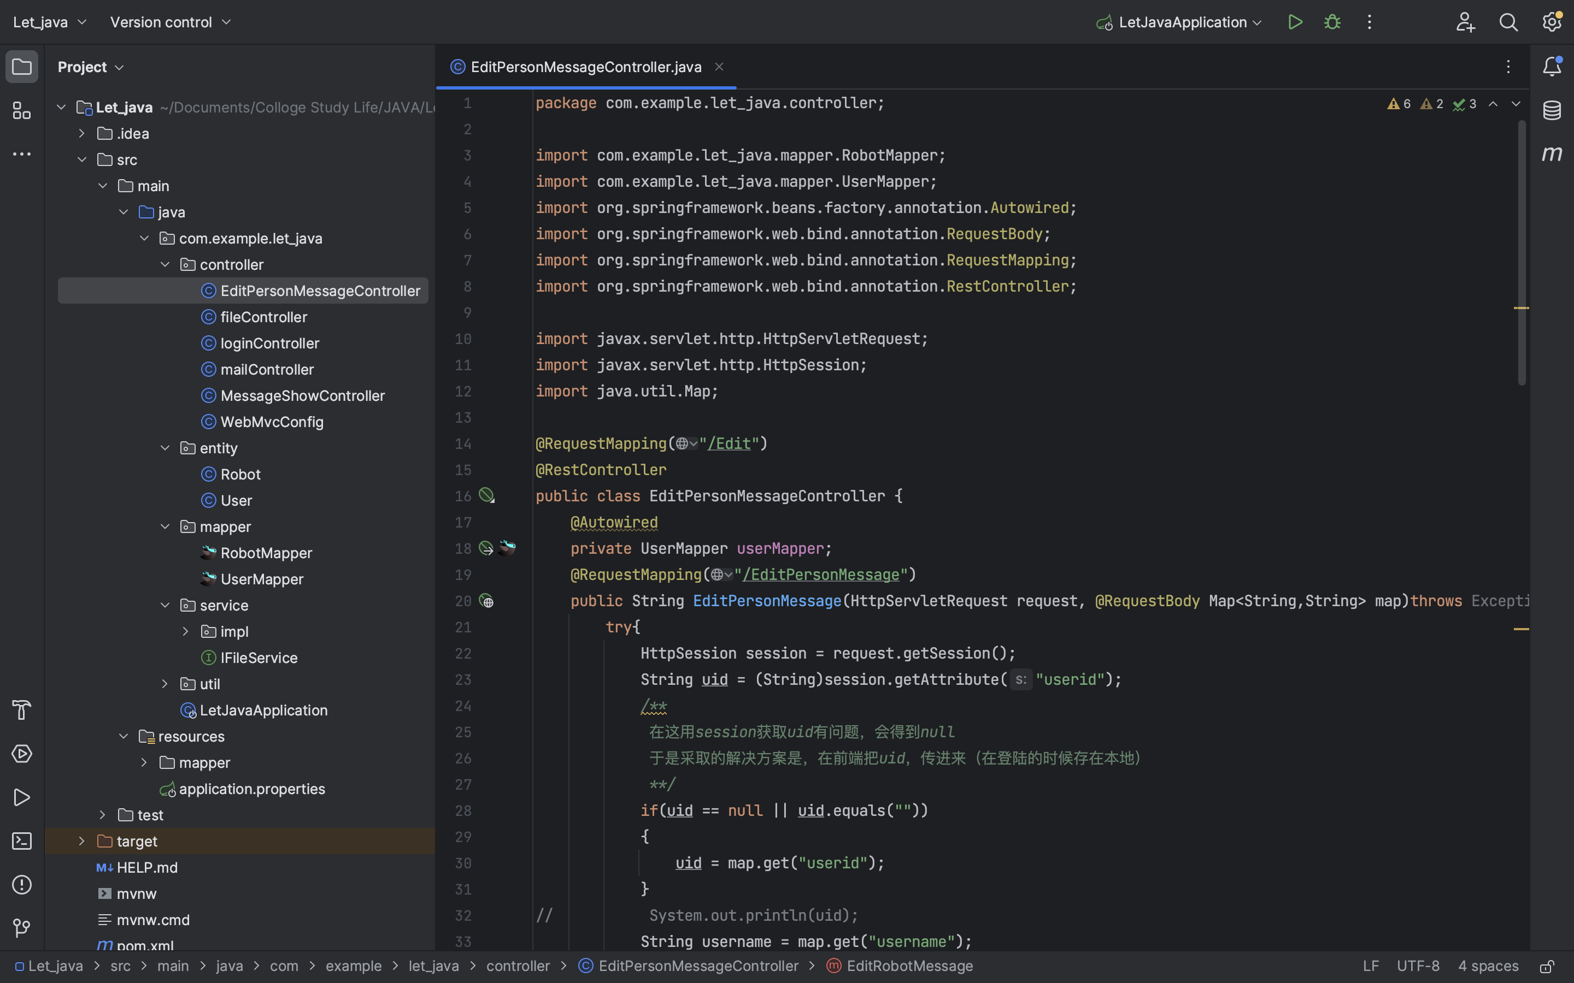

Slide 14
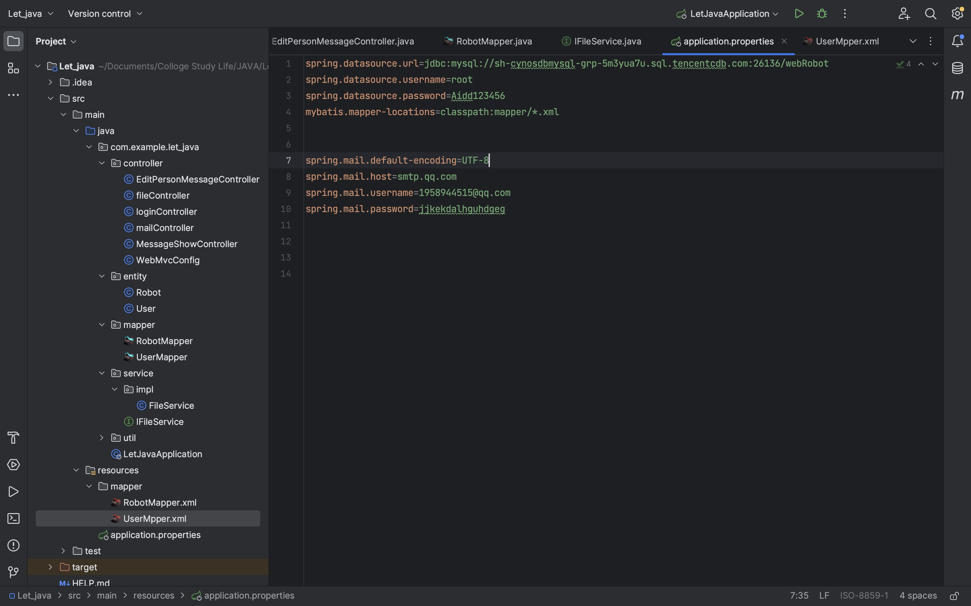
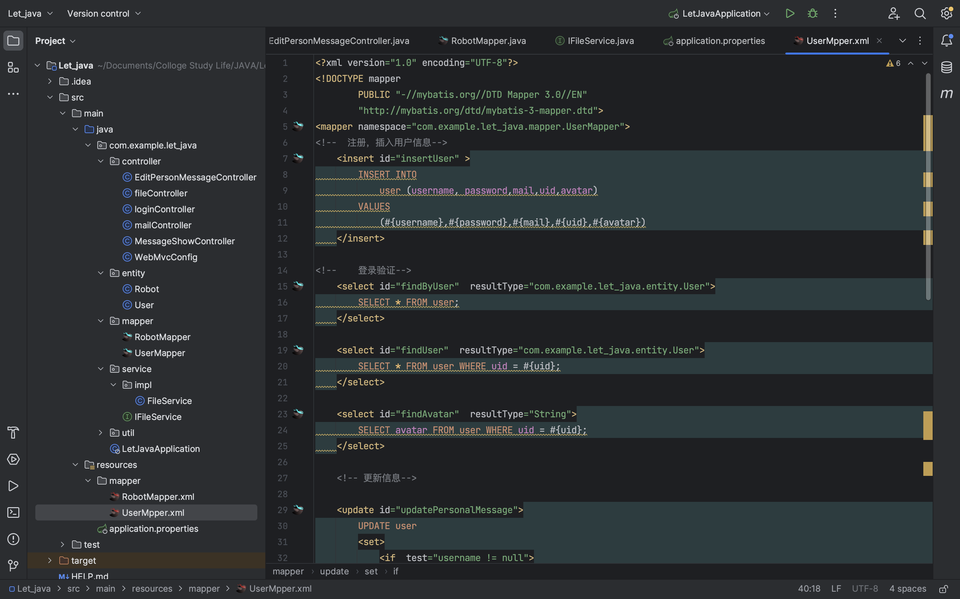

Slide 15
